Slide 1
Office 365 Development

Slide 2
Deep Dive into the Office 365 Unified API

Slide 3















Vision
EXTEND OFFICE EVERYWHERE
CONNECT TO OFFICE 365 SERVICES
BUILD USING AN OPEN PLATFORM
Delve
z
Users and groups
Files
Mail
Calendar
My Apps
Video Portal
Contacts
Office Graph
Presentations
Documents
Spreadsheets
Lync
OneNote
Yammer

Slide 4

Agenda
Authentication Deep-dive
Why the need for Unified API
What is the Unified API
Unified API .NET SDK
Supported Areas
Roadmap

Slide 5
Authentication

Slide 6
Authentication
Secured by Azure Active Directory and OAuth 2.0
No capturing user credentials
Fine-grained access scopes
Supports MFA and federated user sign-in
Long-term access through refresh tokens

Slide 7
demo
Authentication process
Notes:
Perform raw flow from Fiddler with the following details:
APP INFORMATION
CID: {paste your client id here}
PWD: {paste your client secret}
REPLY: {paste your reply url here}
PART 1
https://login.microsoftonline.com/common/oauth2/authorize
?client_id={paste your client id here}
&resource={enter your resource}
&redirect_uri={paste your reply url here}
&response_type=code
PART 2
https://login.microsoftonline.com/common/oauth2/token
grant_type=authorization_code
&redirect_uri={paste your reply url}
&client_id={paste your client id}
&client_secret={paste your client secret}
&code={paste authorization code from previous step}
&resource={enter your resource}
Content-Type: application/x-www-form-urlencoded
PART 3
https://outlook.office365.com/api/v1.0/me/messages
Accept:application/json
Authorization: Bearer {paste your access token}

Slide 8
Why the need for the Unified API?

Slide 9








Data silos in the enterprise
USER
FILES
EMAIL AND CONVERSATIONS
EVENTS
PEOPLE
GROUPS

Slide 10
Directory
USER
PEOPLE
GROUPS
Azure Active Directory Graph API
https://graph.windows.net/contoso.com/users
https://graph.windows.net/contoso.com/groups

Slide 11
Extended Profile
USER
PEOPLE
GROUPS
SharePoint User Profile
https://contoso.sharepoint.com/_api/SP.UserProfiles.PeopleManager/GetMyProperties
Exchange HD Picture
https://outlook.office365.com/api/v1.0/me/userPhoto

Slide 12
Mail, Calendar, and Conversations
USER
EMAIL AND CONVERSATIONS
EVENTS
GROUPS
Exchange REST API
https://outlook.office365.com/api/v1.0/me/Messages
https://outlook.office365.com/api/v1.0/me/Events

Slide 13
Files
USER
FILES
PEOPLE
GROUPS
OneDrive for Business/SharePoint Files API
https://contoso-my.sharepoint.com/personal/yina_contoso_com/_api/v1.0/files
https://contoso.sharepoint.com/sites/designCouncil/_api/v1.0/files

Slide 14
Office Graph
USER
FILES
PEOPLE
GROUPS
Office Graph in SharePoint Online
https://contoso.sharepoint.com/_api/search/query?Querytext='*'&Properties='GraphQuery:actor(ME,action\:1020,or(action\:1020\,action\:1003,action\:1001,action\:1024,action\:1005,action\:1037,action\:1039,action\:1036)'&SelectProperties='Docid,Title

Slide 15
What is the Unified API

Slide 16
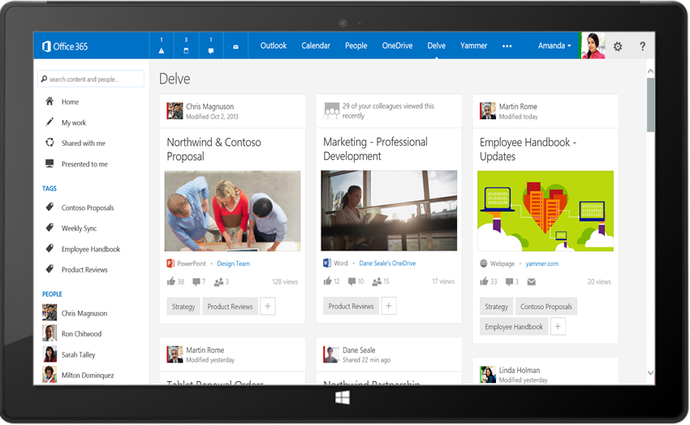
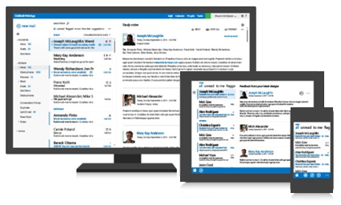
Office 365 unified API
Your App
https://graph.microsoft.com/
USERS
GROUPS
FILES
MAIL
CALENDAR
TASKS
Insights and relationships from Office Graph

Slide 17
Breaking silos
USER
FILES
EMAIL AND CONVERSATIONS
EVENTS
PEOPLE
GROUPS

Slide 18
Benefits to Unified API
Single well-known endpoint
Single well-known resource
Only one OAuth access token needed
Navigate across workloads and relationships logically

Slide 19
Unified API vs. Service APIs
Functionality will likely show up first in service-specific end-points

Slide 20
/me
USER
ME
userPhoto
thumbnailPhoto
responsibilities
department
pastProjects
aboutMe
hireDate
birthday
address
mobile
jobTitle
schools
name
skills
tags
alias

Slide 21
Code
GET https://graph.microsoft.com/beta/contoso.com
/users/yina@contoso.com
GET https://graph.microsoft.com/beta/me
GET https://graph.microsoft.com/beta/contoso.com
/users/<id>
GET https://graph.microsoft.com/beta/contoso.com
/users/yina@contoso.com?$select=aboutMe
GET https://graph.microsoft.com/beta/me/userphotos/96X77

Slide 22
/users
manager
USER
directReports
memberOf
GROUPS

Slide 23
Code
GET https://graph.microsoft.com/beta/me/manager
GET https://graph.microsoft.com/beta/contoso.com
/users/yina@contoso.com/directReports
GET https://graph.microsoft.com/beta/me/memberOf
GET https://graph.microsoft.com/beta/contoso.com
/users/<id>
GET https://graph.microsoft.com/beta/contoso.com
/users/alex@contoso.com/directReports

Slide 24
/messages
manager
USER
directReports
memberOf
GROUPS
MESSAGES

Slide 25
Code
GET https://graph.microsoft.com/beta/me/messages
GET https://graph.microsoft.com/beta/me/messages?$top=5
GET https://graph.microsoft.com/beta/me
/messages?$top=5&$skip=5&$orderby=DateTimeCreated
GET https://graph.microsoft.com/beta/me
/messages?$top=5&$select=Subject,Sender&
$search="from:alexd@contoso.com"

Slide 26
/events
manager
USER
directReports
EVENTS
memberOf
GROUPS
MESSAGES
MESSAGES

Slide 27
Code
GET https://graph.microsoft.com/beta/me/events
GET https://graph.microsoft.com/beta/me/events?$top=5
GET https://graph.microsoft.com/beta/me
/calendarview?startdatetime=2015-04-01t01:00:00z
&enddatetime=2015-04-16t23:00:00z

Slide 28
/files
Shared with me
createdBy
public
manager
USER
directReports
directReports
EVENTS
EVENTS
modifiedBy
FILES
memberOf
GROUPS
MESSAGES

Slide 29
Code
GET https://graph.microsoft.com/beta/me/files
GET https://graph.microsoft.com/beta/me/files/<id>
GET https://graph.microsoft.com/beta/me
/files/<id>/lastModifiedByUser
GET https://graph.microsoft.com/beta/mary@contoso.com/files
GET https://graph.microsoft.com/beta/mary@contoso.com
/files/<id>/lastModifiedByUser/manager

Slide 30
/groups
Shared with me
Shared with me
createdBy
createdBy
CONVERSATIONS
public
public
manager
USER
directReports
directReports
directReports
directReports
EVENTS
EVENTS
modifiedBy
modifiedBy
FILES
FILES
memberOf
memberOf
GROUPS
GROUPS
createdBy
MESSAGES
FILES

Slide 31
Code
GET https://graph.microsoft.com/beta/contoso.com
/groups?$filter=groupType+eq+'Unified'
GET https://graph.microsoft.com/beta/contoso.com/groups/<id>/members
GET https://graph.microsoft.com/beta/contoso.com
/groups/<id>/files
GET https://graph.microsoft.com/beta/contoso.com
/groups/<id>/conversations
GET https://graph.microsoft.com/beta/contoso.com
/groups/<id>/events/<id>/accept

Slide 32
/workingWith
Shared with me
createdBy
CONVERSATIONS
CONVERSATIONS
public
manager
USER
workingWith
directReports
directReports
EVENTS
EVENTS
EVENTS
modifiedBy
FILES
memberOf
memberOf
memberOf
workingWith
GROUPS
GROUPS
GROUPS
createdBy
createdBy
MESSAGES
FILES
FILES

Slide 33
Code
GET https://graph.microsoft.com/beta/me/workingWith
GET https://graph.microsoft.com/beta/contoso.com
/users/yina@contoso.com/workingWith
GET https://graph.microsoft.com/beta/contoso.com
/users/mary@contoso.com/workingWith

Slide 34
/trendingAround
trendingAround
Shared with me
createdBy
CONVERSATIONS
public
workingWith
manager
USER
workingWith
directReports
directReports
directReports
EVENTS
EVENTS
trendingAround
modifiedBy
FILES
memberOf
memberOf
workingWith
workingWith
GROUPS
GROUPS
createdBy
MESSAGES
FILES

Slide 35
Code
GET https://graph.microsoft.com/beta/me/trendingAround
GET https://graph.microsoft.com/beta/contoso.com
/users/yina@contoso.com/trendingAround
GET https://graph.microsoft.com/beta/contoso.com
/users/mary@contoso.com/trendingAround

Slide 36
API
trendingAround
Shared with me
createdBy
CONVERSATIONS
public
manager
USER
workingWith
directReports
EVENTS
trendingAround
modifiedBy
TASKS
FILES
memberOf
workingWith
TASKS
GROUPS
createdBy
NOTES
NOTES
MESSAGES
FILES

Slide 37
API
trendingAround
Shared with me
createdBy
CONVERSATIONS
public
manager
USER
workingWith
directReports
EVENTS
trendingAround
https://graph.microsoft.com/
modifiedBy
TASKS
FILES
memberOf
workingWith
TASKS
GROUPS
createdBy
NOTES
NOTES
MESSAGES
FILES

Slide 38
demo
Graph Explorer
https://graphexplorer2.azurewebsites.net
Notes:
https://graph.microsoft.com/beta/me
https://graph.microsoft.com/beta/me/manager
https://graph.microsoft.com/beta/me/messages
https://graph.microsoft.com/beta/me/events
https://graph.microsoft.com/beta/me/files
https://graph.microsoft.com/beta/me/files/{id}/createdbyuser/manager
https://graph.microsoft.com/beta/me/files/{id}/createdbyuser/manager/?$whatif
https://graph.microsoft.com/beta/myorganization/users
https://graph.microsoft.com/beta/myorganization/groups
https://graph.microsoft.com/beta/me/joinedgroups
https://graph.microsoft.com/beta/me/joinedgroups/{id}/files
https://graph.microsoft.com/beta/me/joinedgroups/{id}/conversations

Slide 39
Unified API Native SDKs

Slide 40
Unified API Native SDKs
Native SDKs available for all platforms supported by the Office 365 APIs
Native .NET SDK
NuGet Package: Microsoft.Graph

Slide 41
demo
Unified API .NET SDK

Slide 42
What is supported now?

Slide 43
Supported functionality
Users
Files
Mail
Calendar
Org. Contacts
Groups*
Social Activity*
Commercial
OAuth2.0
CORS
CRUD
OData query operations
Actions and functions
Client libraries .Net, Android, iOS

Slide 44
API
trendingAround
Shared with me
createdBy
CONVERSATIONS
public
manager
USER
workingWith
directReports
EVENTS
trendingAround
https://graph.microsoft.com/beta/$metadata
modifiedBy
TASKS
FILES
memberOf
workingWith
TASKS
GROUPS
createdBy
NOTES
NOTES
MESSAGES
FILES

Slide 45
What’s coming next?

Slide 46
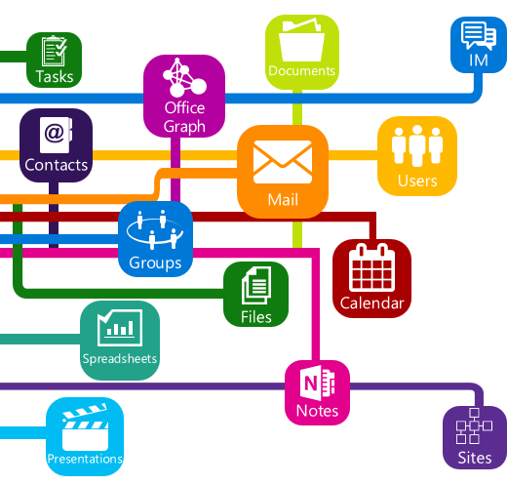
Roadmap
Notifications / web hooks
Consumer
Instant-on
Personal contacts
Tasks
Notes
Skype
Additional insights and relationships
Extensibility

Slide 47
Summary
Authentication Deep-dive
Why the need for Unified API
What is the Unified API
Unified API .NET SDK
Supported Areas
Roadmap

Slide 48



dev.office.com
Sign up
http://dev.office.com/getting-started
Explore
http://apisandbox.msdn.microsoft.com
Get trained http://dev.office.com/training

Slide 49


Feedback
Office 365 Network Share you best practices and join conversations https://www.yammer.com/itpronetwork
Stackoverflow Ask deep technical questions to a world-wide set of developers
http://stackoverflow.com/questions/tagged/ms-office
UserVoice Provide suggestions of what you want in future versions
http://officespdev.uservoice.com/

